Slide 1
Oracle Application Express (APEX)
Project Implementation for
COSC 5050 Distributed Database Applications
Lab3

Slide 2
Creating APEX Reports
Creating and customizing report
Column format (date/time, price)
Column sorting
Pagination
Creating parameterized report
Creating drill down report

Slide 3
Oracle APEX Report
An Oracle APEX report is the formatted result of a SQL query
Reports can be generated by defining a report region based on a SQL query
Create a report based on a custom SQL SELECT statement

Slide 4
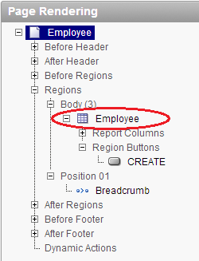
Editing Report Attributes
Customizing reports
SQL report and interactive report
Accessing the report attributes page from report region
Column attributes
Layout and pagination
Sorting
Report export/download
Break formatting

Slide 5
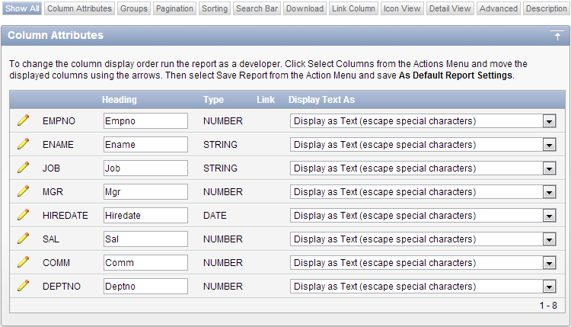
Editing Report Attributes
Altering report layout using column attributes

Slide 6
Editing Report Attributes
Altering column name
Alignment
Sort
Pagination – number of rows
Report export – CSV, xml
Sum of column
Formatting number and date/time
Column move up/down

Slide 7
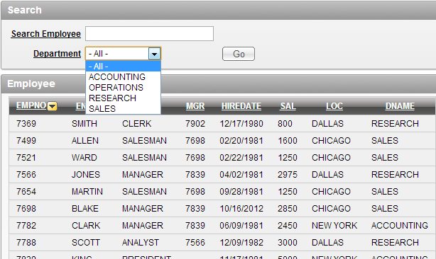
Creating Parameterized Report
Parameterized report
The results depend on the form input
The report region is based on a SQL query that references the value of form items within the application
Will create
A blank page
A search region
Form items
Submit button
A query region
A process

Slide 8
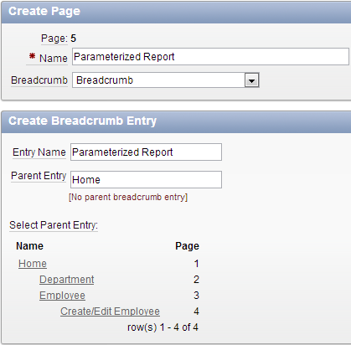
Creating a Blank Page
Use AnyCo Corp application and add a new blank page
In the application home
Create Page → Blank Page → Next
Page name: Parameterized Report
Breadcrumb: Breadcrumb
Breadcrumb parent entry: Home

Slide 9
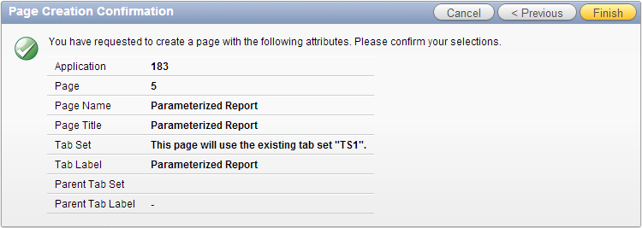
Creating a Blank Page
Tab options
Use an existing tab set and create a new tab within the existing tab set
Tab set: TS1 (Home, Department, Employee)
New tab label: Parameterized Report

Slide 10
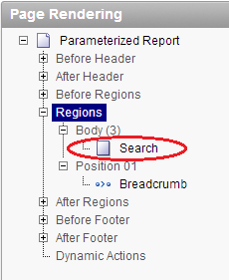
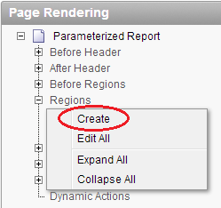
Creating a Search Region
Create a search region
Edit the page → right click Regions → Create
Region: HTML → HTML
Title: Search
Take other defaults → Create

Slide 11
Creating a Query Region
Create a query region
Regions → Create
Type of region: Report → Classic Report
Title: Employee &P??_TEXT.
&P??_TEXT is a substitution string
P?? is the page number, use your current page number
Do not forget the period at the end, it is needed as part of the title
Enter SQL Query (change to your page number)
Column Heading Sorting: Yes
Take other defaults → Create Region
Notes:
SELECT EMPNO, ENAME, JOB, MGR, HIREDATE, SAL, LOC, DNAME
FROM DEPT, EMP
WHERE EMP.DEPTNO = DEPT.DEPTNO
AND LOWER(ENAME) LIKE '%' || LOWER(:P??_ENAME) || '%'
AND EMP.DEPTNO = DECODE(:P??_DEPT,null,EMP.DEPTNO,:P??_DEPT)

Slide 12
The Decode Function
The function has the functionality of an IF-THEN-ELSE statement
Syntax for the decode function
decode ( expression , search , result [, search , result]... [, default] )
Expression -- the value to compare
Search -- the value that is compared against expression
Result -- the value returned, if expression is equal to search
Default is optional
If no matches are found, the decode will return default
If default is omitted, then the decode statement will return null (if no matches are found)
Notes:
EMP.DEPTNO = DECODE(:P10_DEPT,null,EMP.DEPTNO,:P10_DEPT)
Means:
IF (:P10_DEPT IS null) THEN
EMP.DEPTNO = EMP.DEPTNO;
ELSE
EMP.DEPTNO = :P10_DEPT;
ENDIF;

Slide 13
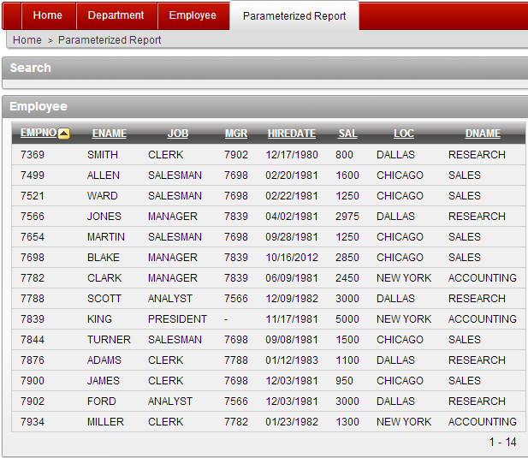
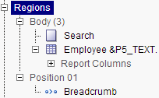
Testing the Created Regions
Two regions have been created
HTML search region
SQL query report region

Slide 14
Adding Form Items
Add following form items in the HTML search region
The search employee text field for P??_ENAME
A hidden text field for P??_TEXT
The department select list for P??_DEPT
A submit button
Add a process to set the hidden text field

Slide 15
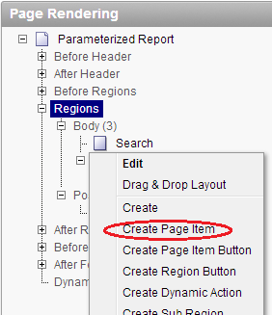
Search Employee Text Field
Create search employee text field for P??_ENAME
Edit the page → right click Search → Create Page Item → Text field
Item name: P??_ENAME
(use your page number)
Region: Search
Label: Search Employee
Take other defaults → Create Item

Slide 16
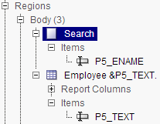
Hidden Field
Create hidden field for P??_TEXT
Edit the page → right click Search → Create Page Item → Hidden
Item name: P??_TEXT (use your page number)
Region: Employee &P??_TEXT.
Take other defaults → Create Item

Slide 17
Department Select List
Create department select list for P??_DEPT
Edit the page → right click Search → Create Page Item → Select List
Item name: P??_DEPT (use your page number)
Region: Search
Label: Department
Null display value: – All –
List of value query:
Take other defaults → Create Item
Notes:
select DNAME as display_value, DEPTNO as return_value
from DEPT
order by 1

Slide 18
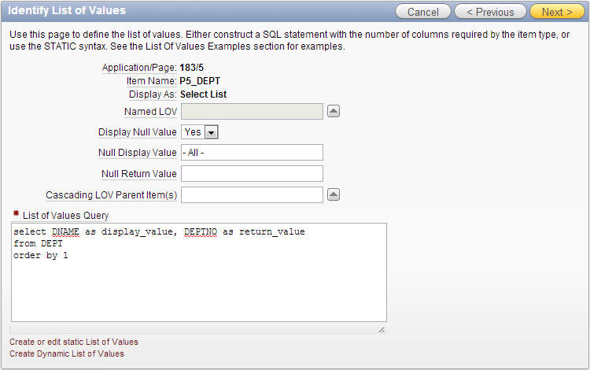
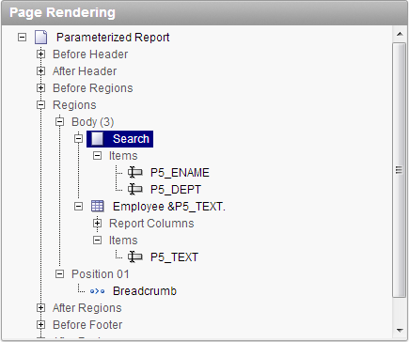
Department Select List

Slide 19
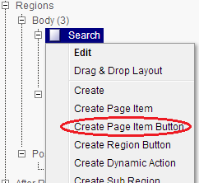
Submit Button
To submit the page, add a submit button
Once the user enters search criteria, the page needs to be submitted so that the query will be rerun against that criteria
Create button
Edit the page → right click Search
→ Create Page Item Button
Button name: P??_GO
Button label: Go
Take other defaults → Create Button

Slide 20
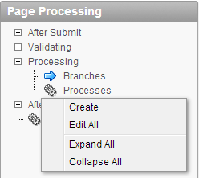
Process
Create a process that sets the value for the hidden item P??_TEXT.
The value of P??_TEXT determines the region title
Create process
In Page Processing area, right click Processes → create
Category of process → PL/SQL
Name: get region title info
Enter PL/SQL page process:
Take other defaults → Create Process
Notes:
DECLARE
L_DEPT VARCHAR2(100);
BEGIN
:P??_TEXT := NULL;
IF :P??_DEPT IS NOT null
THEN
SELECT DNAME INTO L_DEPT FROM DEPT WHERE DEPTNO = :P??_DEPT;
:P??_TEXT := :P??_TEXT || ' IN DEPARTMENT ' || L_DEPT;
END IF;
END;

Slide 21
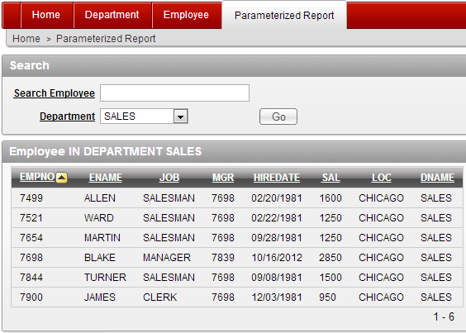
Run Parameterized Report

Slide 22
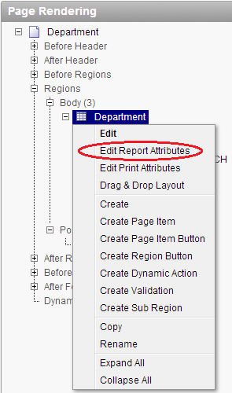
Creating Drill Down Report
Linking the Department report to the Employee report
Edit department report page (page 2)
In the Regions area:
Department → Edit report Attributes

Slide 23
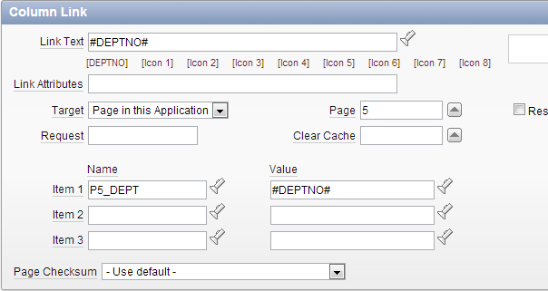
Creating Drill Down Report
Linking the Department report to the Employee report
Edit DETPNO column → Column Link
Link text: #DEPTNO# (this is a template substitution)
Target: Page in this application
Page: 5 (target to Parameterized Report page, use your page number)
Set item 1 session state
Name: P??_DEPT
Value: #DEPTNO#
→ Apply Changes

Slide 24
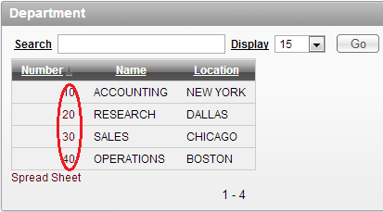
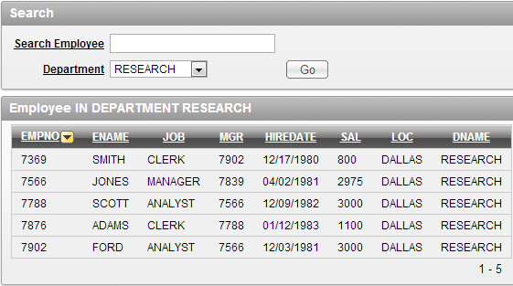
Creating Drill Down Report
Click department number to drill down to employee report for the choose department
Notes:
May need to modify the process point of process “get region title info”.

Slide 25
Readings
Application Express User’s Guide
Building an Application
Creating Reports
Application Express Advanced Tutorials
How to create a parameterized report
How to create a drill down report

